Slide 1
CHAPTER 7 the logic of sampling

Slide 2
Definitions
Sampling – The process of selecting observations from a population
Population == All members of a particular group

Slide 3
Why Sample?
Populations vary greatly in size
  Small population?
  Large population?
For most psychologists, our target population is all people.
Cannot measure all people!

Slide 4
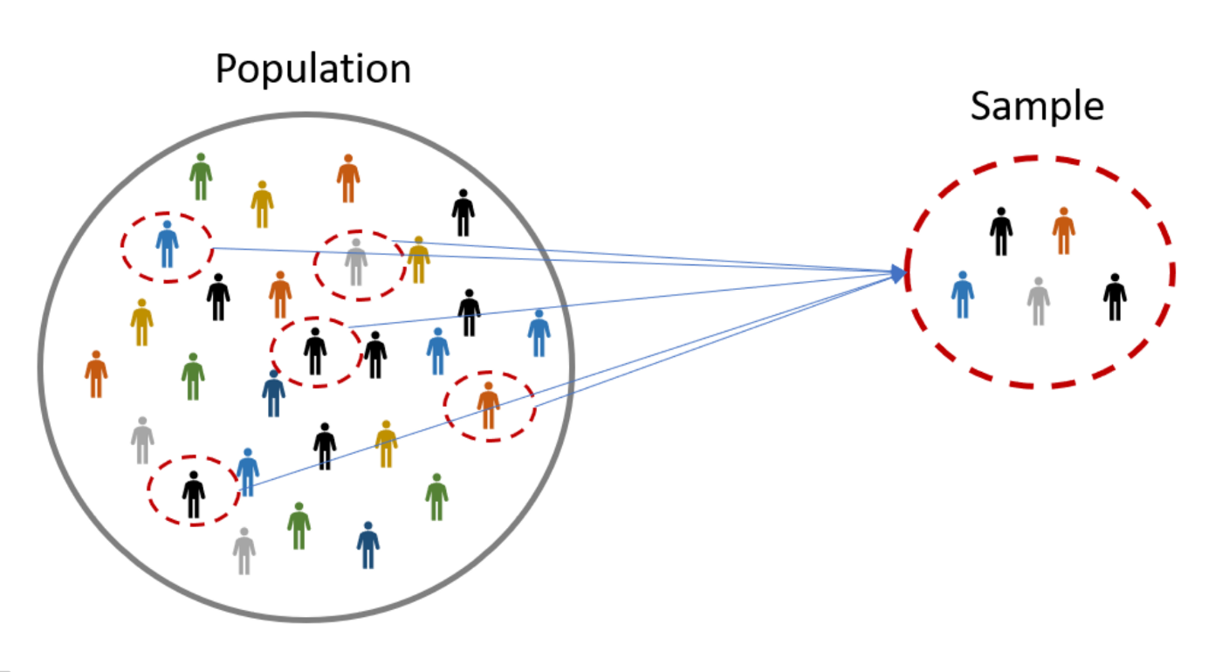

Slide 5
Sampling Considerations
Who is your sample?
Where will you recruit them from?
Do they accurately reflect the population?

Slide 6
Sampling Considerations
Bad sample == inaccurate results
  Potentially miss an effect or find an effect that doesn’t exist in the “real world”

Slide 7
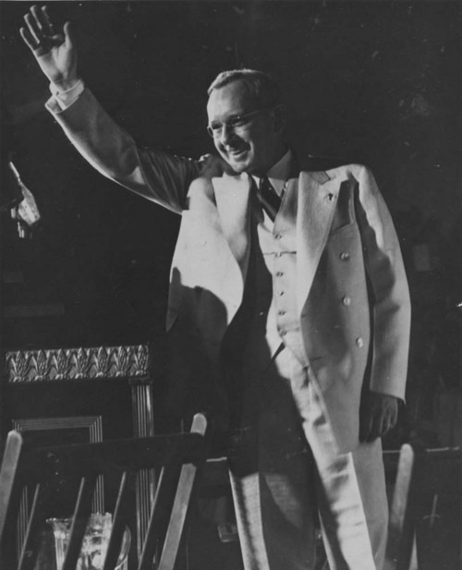
1936 Presidential Election
President Alf Landon

Slide 8
1936 Presidential Election
President Alf Landon
  Literary Digest poll, 1936
  Two million ballots mailed to people listed in telephone directory
  Ballots predicted a large Landon Victory

Slide 9
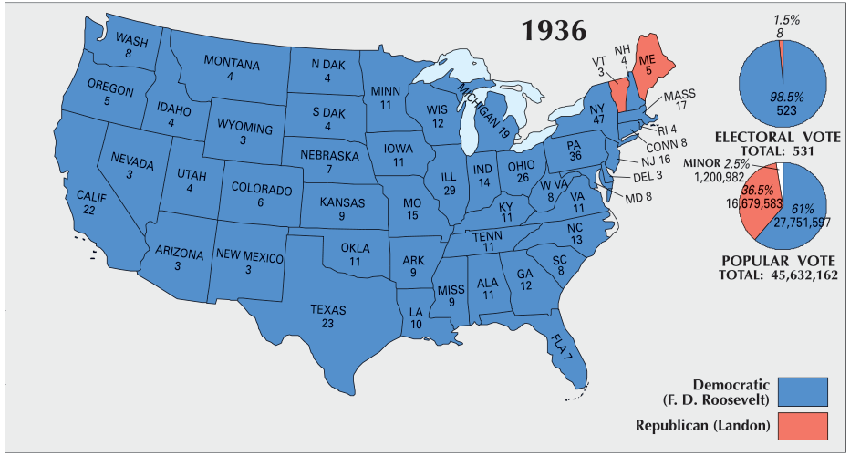
A Brief History of Sampling
President Alf Landon
  FDR won in a landslide…

Slide 10
1936 Presidential Election
What went wrong???
Pre-election polling was flawed!
  Based on the “Literary Digest Poll”
    Based on a sample of 2.7 million individuals
    Poll began in 1916
      Always predicted the correct winner!

Slide 11
1936 Presidential Election
Flawed Polling
Literary Digest primarily polled its own readers, car owners, and telephone owners
  Wealthy!
Response bias!
  Most people voting for FDR didn’t respond to the poll!

Slide 12
1948 Presidential Election
Thomas Dewey vs. Harry S Truman
Dewey predicted to win in a landslide

Slide 13
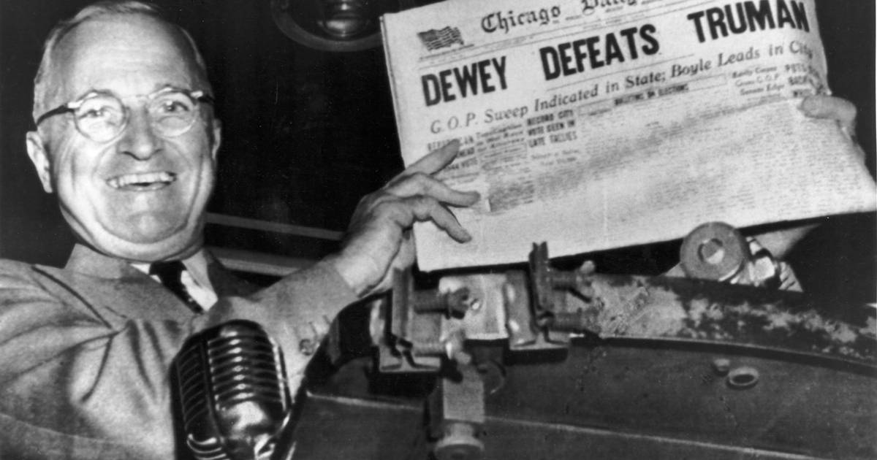
1948 Presidential Election
“President” Thomas E. Dewey
  Gallup’s quota sampling
  Problems?

Slide 14
1948 Presidential Election
Gallup’s quota sampling
Quota frames were based on 1940 census
  Urban migration during WWII
  Underrepresented urban masses
Stopped polling in October 1948 (~ 1 month before election day)

Slide 15
Nonprobability Sampling
Nonprobability Sampling – Any technique in which samples are selected in some way not suggested by probability theory.
  Available subjects (convenience sampling)
  Quota sampling

Slide 16
Nonprobability Sampling
Reliance on Available Subjects
  Does not allow for control over representativeness.
  Only justified if less risky methods are unavailable.
  When might this method be appropriate?

Slide 17
Nonprobability Sampling
Quota Sampling – Participants are selected based on pre-specified characteristics
  Total sample will have the same distribution of characteristics assumed to exist in the population being studied.
  Similar to probability sampling, but has problems
    quota frame must be accurate, selection of sample elements may be biased!

Slide 18
Sampling techniques
If all members of a population were identical in all respects, there would be no need for careful sampling procedures.
Not the case! Lots of individual differences!
A sample of individuals from a population must contain the same variations that exist in the population.

Slide 19
Sampling bias
Need to be aware of Conscious and Unconscious Sampling Bias!
  Bias – Those selected are not typical nor representative of the larger population.

Slide 20
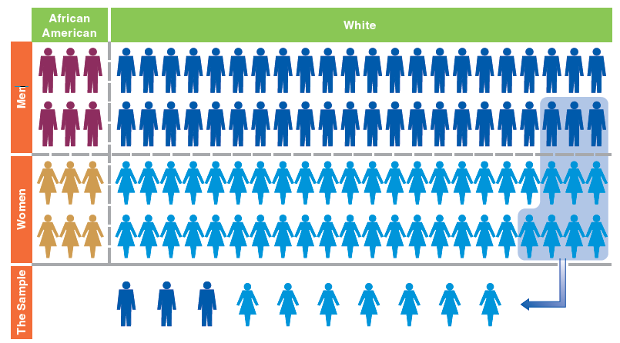
Is this a good sample?

Slide 21
Representativeness
A good sample is representative of the population
  Representativeness – Sample has the same distribution of characteristics as the population from which it was selected.
  Samples need not be representative in all respects, only those relevant to the research!

Slide 22
Probability Sampling
  A sample will be representative of the population from which it is selected if all members of the population have an equal chance of being selected in the sample.
  How can we ensure equal chance?

Slide 23

Probability Sampling
Random selection!
  Ensures that each member of population has equal chance of being selected
Enough people == representative!

Slide 24
Probability Sampling
  Statistic – the summary description of a variable in a sample, used to estimate a population parameter.
    We can use statistics to make inferences about population based on our sample
  Sampling Error – The degree of error to be expected of a given sample design.
    No sample will perfectly represent population!

Slide 25
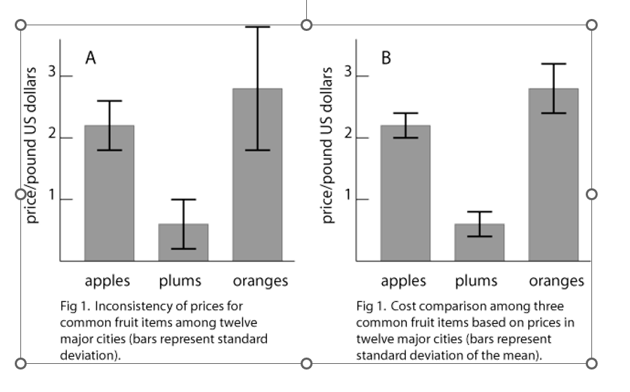
Sampling Error

Slide 26
Types of Sampling Designs
Simple Random Sampling – Units of a population are assigned numbers. Random numbers are generated and the units having those numbers are included in the sample.
Downsides:
  Not necessarily the most accurate sampling method.
  Requires access to all members of your population

Slide 27
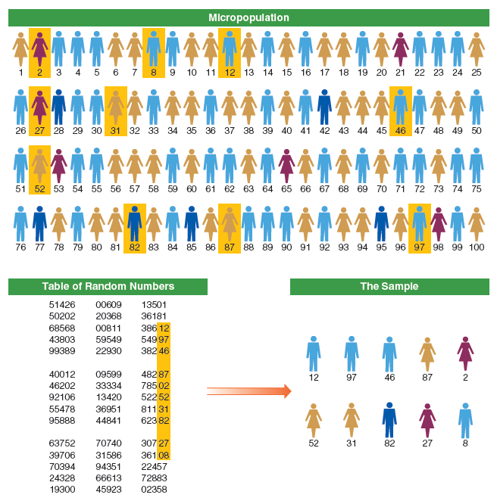

Slide 28
Types of Sampling Designs
Systematic Sampling – A type of probability sampling in which every k^{th} unit in a list is selected for inclusion in the sample.
  Example: Every third person
  Slightly more accurate than simple random sampling.
  Again, need to know your whole population

Slide 29
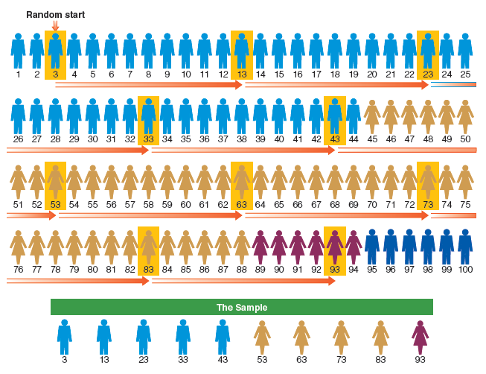

Slide 30
What do we do in psych?
Convenience sampling!
  Who is our population? What members of our population do we actually have access to?
  Potential problems w/ representativeness
Potentially good if you don’t have access to whole population!

Slide 31
Convenience sampling
How to ensure representativeness?
  Sample from a large group! Make sure that all group members have equal access
    Example: All undergrads in PSYC 1103 can take this study
  For experimental research: Randomly assign participants to conditions!

